Slide 1
Analyzing and Predicting Outcomes of Cricket Matches
By Parikshit Shembekar
Dipesh Virkar
Professor - Dr Carol Romanowski

Slide 2
Index
Introduction
Data Understanding
Data Preparation
Objective
Current Work
Results
Future Work
Conclusion

Slide 3
Introduction
Cricket is a game played with bat and ball wherein two teams, each of 11 players, compete against each other on a 20 meter pitch by scoring runs and taking wickets.
At a given time, the batting team has 2 players on the pitch and the bowling team has 11 players on the field one of which is a bowler.
Each player on the batting team scores runs by running between the pitches or hitting boundaries (4 or 6 runs). The team score is the total score of each individual player
Each team has 10 wickets, so the aim of the bowling team is to get the 10 wickets as soon as possible. The goal is to outperform the other team by scoring more runs.

Slide 4
Introduction
Cricket is a huge business market, especially in India. Hence analyzing this game, could be considered one of the most interesting data mining projects. There are hundreds of statistics to compare and analyze from, each being important in their own way.
Cricket being a big money market, there is a great demand for prediction of the match winner, which can be used for betting purposes.

Slide 5
Objective
We wanted to leverage the fact that this data set gives us ball to ball information of every match. This was a crucial information, with which multiple predictions and conclusions were possible.
As we had data about the team matches played, it was possible to predict the winner based on past matches. Many features given in the data set like venue, bowler to batsman ball by ball performance, can be used to somewhat predict the winner of the match.
Thus, we could predict the winner of the next match International ODI or T20 match based on the right feature selection.

Slide 6
Data Understanding
This data was collected from obtained cricsheet.org which is a data repository containing ball by ball information about around 3994 cricket matches in CSV and YAML format
It contains information like match results, the umpire of the match and most importantly ball to ball information of every match. This information was about the current batsman and bowler, how many balls were played, runs scored at each ball, wickets taken at each ball.
We believe we have sufficient background and knowledge in in this game, and hence would be able to take the decisions of considering and not considering features while predicting or analyzing the results.

Slide 7
Data Preparation
Data cleaning is one of the most important steps in data mining.
It involves processing of the given resource data by correcting or removing data which is redundant and fixing the missing or incomplete data with appropriate values.
This may involve modifying the original data resource to fit in better for specific data mining needs.

Slide 8
Data Preparation **
YAML files were used for analysis of this project
YAML stands for YAML Ain’t Markup Language, which is a human readable data serialization language. It is used to store data in a structured format.
It provides same functionality as a JSON or XML file. These files have specific tags, for each component, and the information related to each component is stored in the corresponding tags.
It creates mappings for each component, and has values which can be string, numbers, arrays, lists.

Slide 9
Data Preparation
An example for mapping can be Winner: India. In this example winner is the key and India is the value.
A key can store a value or a list as well. For example, deliveries: -0.1 -0.2 -0.3. In this example deliveries in the key have sequences 0.1,0.2,0.3. Sequences start with – (dash).
After loading the file into a dictionary say mydict, one can easily access the components by using the dictionary. For example accessing deliveries as mydict[`deliveries'][0] this will let us access the data stored in deliveries: 0.1.

Slide 10
Current Work
1. Predict which of the given two teams would win
Features like number of runs scored, class of runs( Class A: > 300, Class B: 250 < Runs < 300, Class C: 200< Runs < 250 and Class D: < 200) were used
Similar classes were created for the number of wickets between ( 1-10). We found top 3 batsmen in terms of runs for each team and then checked if each of the batsman were playing in the match that we want to predict.
Our other features were the toss decision, toss winner, the over and ball number and the number of runs scored on that delivery

Slide 11
Current Work
2. Predicting if a given team could win while chasing
In this we needed to keep track of how each team has performed while batting first against our target team. We maintain a similar feature vector as our first case.
In our prediction stage, we do not check the 2nd innings score of our team, and on the basis of team batting first's runs scored we make the prediction.

Slide 12
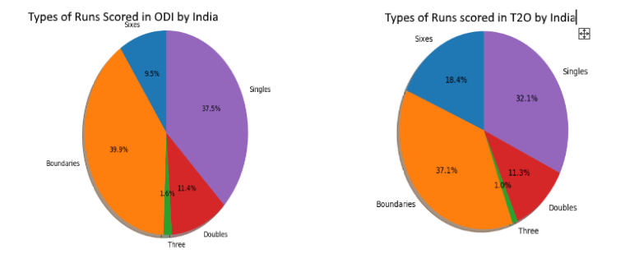
Data Visualization

Slide 13
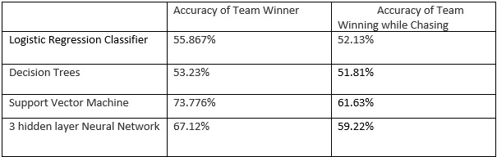
Results

Slide 14
Future Work **
Initially, in our project proposal phase we had planned to make prediction for a batsman vs bowler, that is for a given batsman and a given bowler, predict what would happen on the next ball, would it be four, six or a wicket?
But as we got into the data exploration phase, we realized that our data was unsuited for this task. To make such kinds of predictions we needed quantitative information of the swing, spin of the ball, the length of the delivery, the pitch condition etc.
We have stadium information, but even that information is insufficient as, the pitch and outfield quality depends upon the current weather, which is missing in our data.

Slide 15
Conclusion
Generally, cricket matches are very hard to predict, as right from the toss and the weather condition, a lot of uncertainties are involved. One can easily predict the winner of the match at the beginning with a 50% accuracy as, either of the team has the equal chances of winning.
We attempted to observe the performance of machine learning models on predicting match winners, and we have achieved a score of around 73\% which is way better than chance accuracy of 50%
Creation of better datasets which takes into account various details like length, speed, swing of each delivery will enable player performance prediction for a given delivery.

